Slide 1

The City of Leeds
The Housing of the Working Class Act, 1890
Quarry Hill Unhealthy Area, 1900s
Book of Reference
Part I. Nos. 1 to 1011
November, 1900

Slide 2
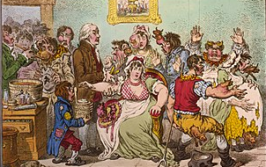
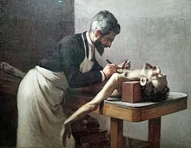
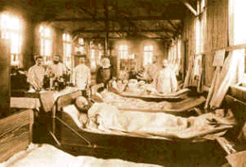
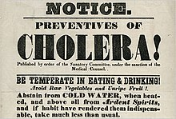

Timeline of the events that led to the unhealthy outcomes in Quarry Hill
  1600s: The Bubonic plague, known as the Black Death, kills many of people.
  1700s: Smallpox outbreaks and causes many deaths.
  1800s – 1900s:
        Cholera outbreaks have become a major public health concern
        The infectious disease Tuberculosis, or TB, affects crowded areas
        The bacterial infection Diphtheria affects the child’s respiratory system
        Typhoid fever was a major public health concern during the 1800s
        Measles was a highly contagious viral disease in the early 1900s
(Jones, 2021)

Slide 3
What factors led to the poor living conditions and unhealthy outcomes in Quarry Hill during the early 1900s?
Quarry Hill, was known for its industrialization in early 1900s, attracted skilled professionals from various parts of the World. Most of the occupants were low-income families and workers. After going through the available literature, these factors were found as major contributors to unhealthy outcomes .
Environmental Pollution
Poverty & Low-income Families
Social Deprivation
Industries and Mills pollution
Poor Sanitation & Ventilation
Overcrowded Housing
Poor Housing Condition
Limited Access to Healthcare
Lack of Health Awareness
(McGuire, 2013)
Notes:
These are the few major causes that led to poor living conditions in Quarry Hill during the early 1900s.

Slide 4
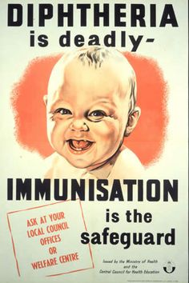
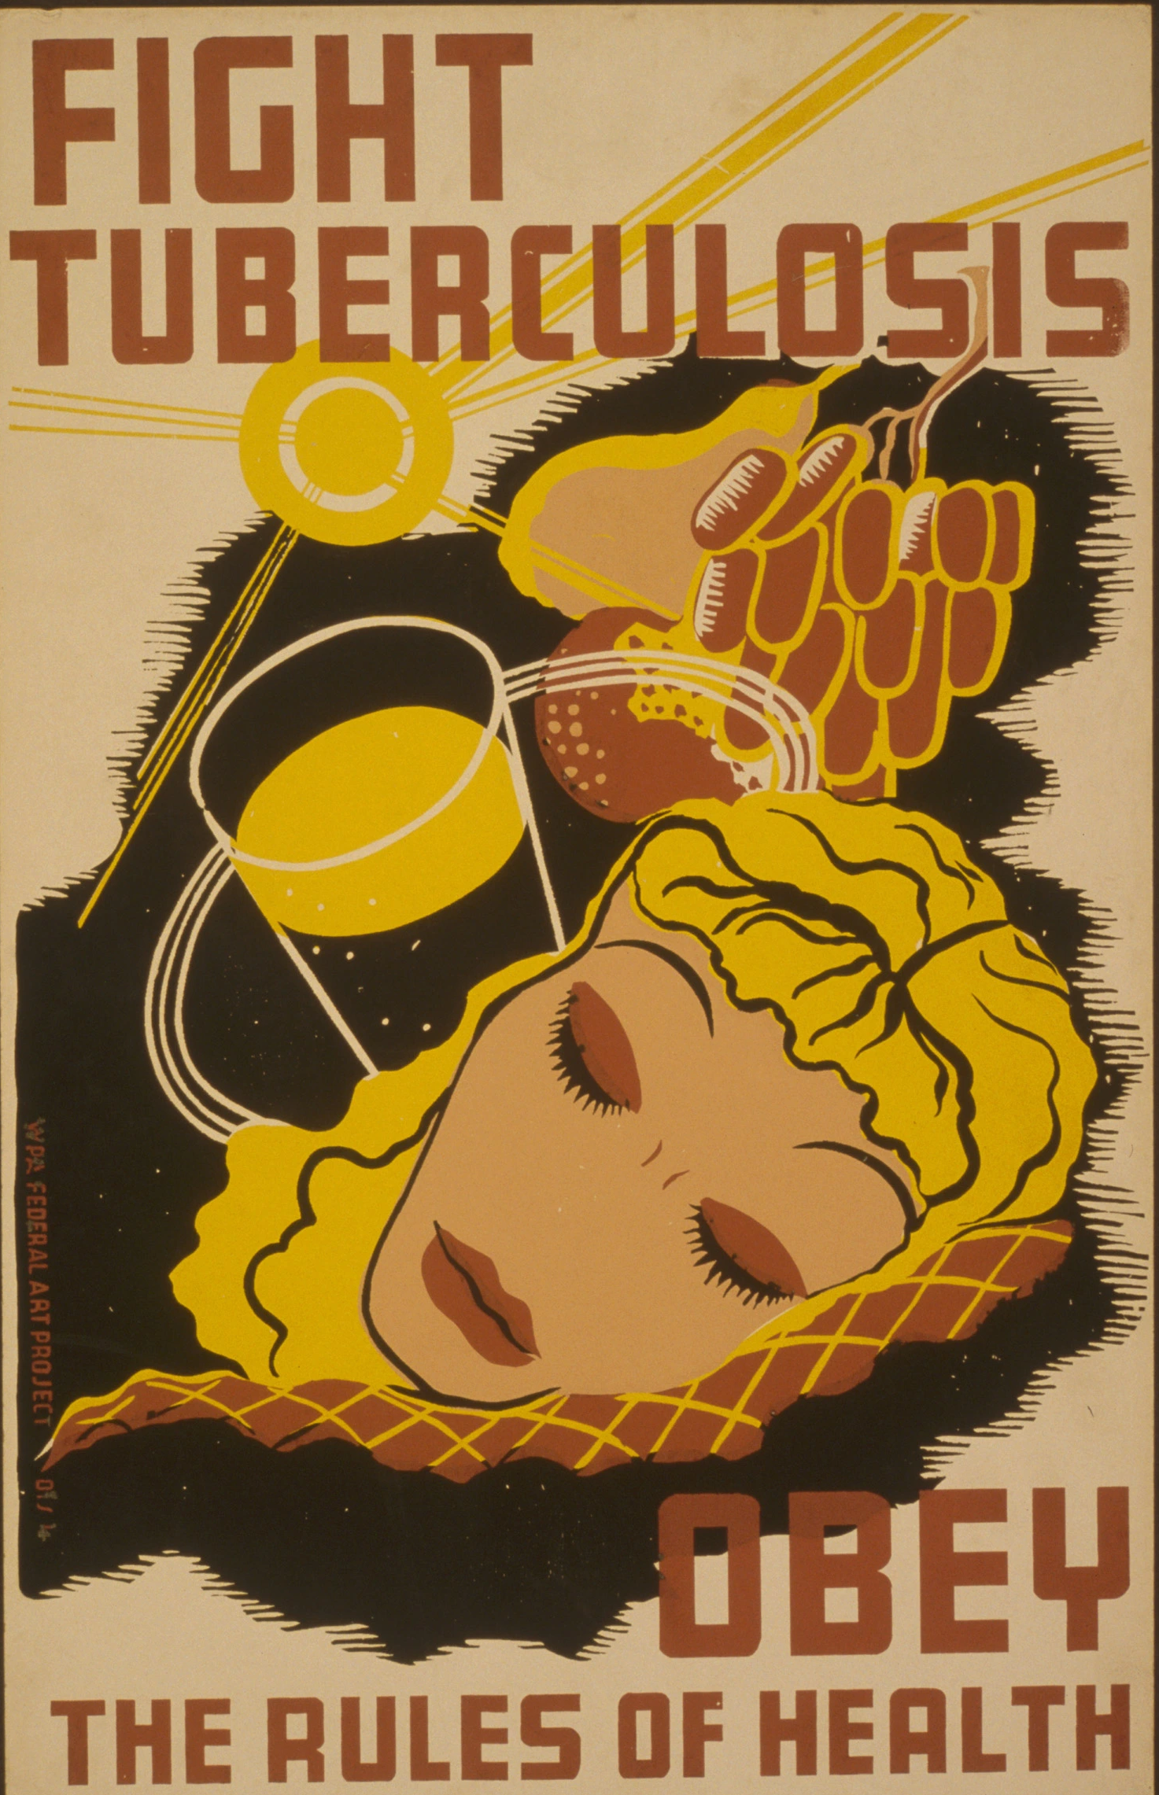
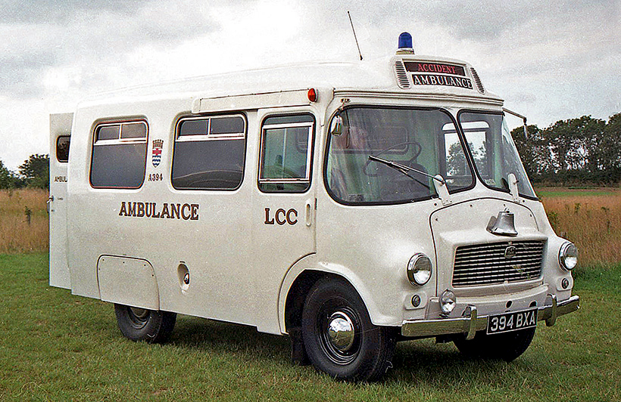
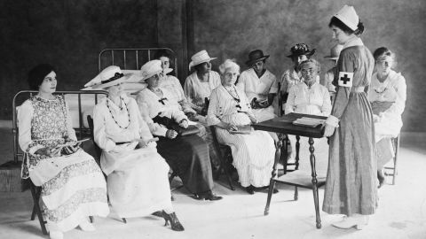
How did the concerned authorities and health officials, responded to the unhealthy conditions in Quarry Hill during the early 1900s?
The authorities implemented public health interventions and regulatory measures aimed at improving hygiene and sanitation practices among residents by providing education and training, stressing the importance of hand washing and proper waste disposal, by distributing pamphlets and posters to promote good hygiene practices (McGuire, 2013).

Slide 5
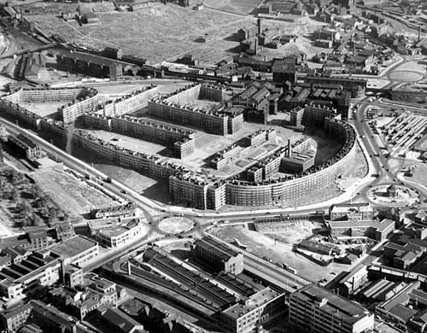
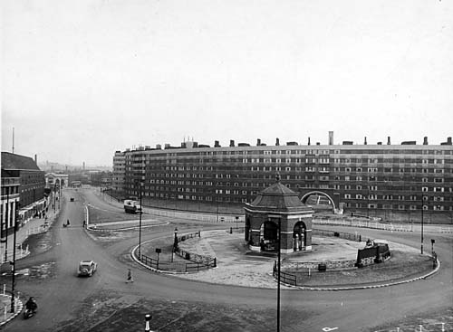
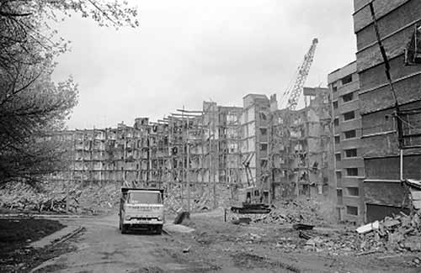
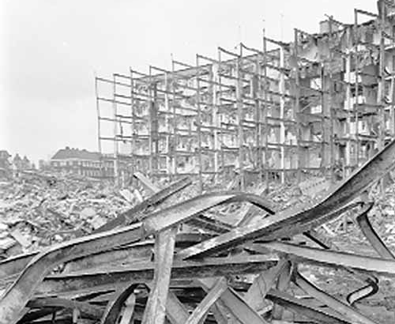
How did the concerned authorities and health officials, responded to the unhealthy conditions in Quarry Hill during the early 1900s?
The government recognized the need to construct Quarry Hill flats in the city's slums, designed to be more spacious and offer better access to sanitation and hygiene facilities. However, the Quarry Hill flats failed due to a lack of basic amenities such as indoor plumbing, central heating, dumping, sewerage issues, and ventilation problems, making them uncomfortable and difficult to live in (McGuire, 2013).

Slide 6
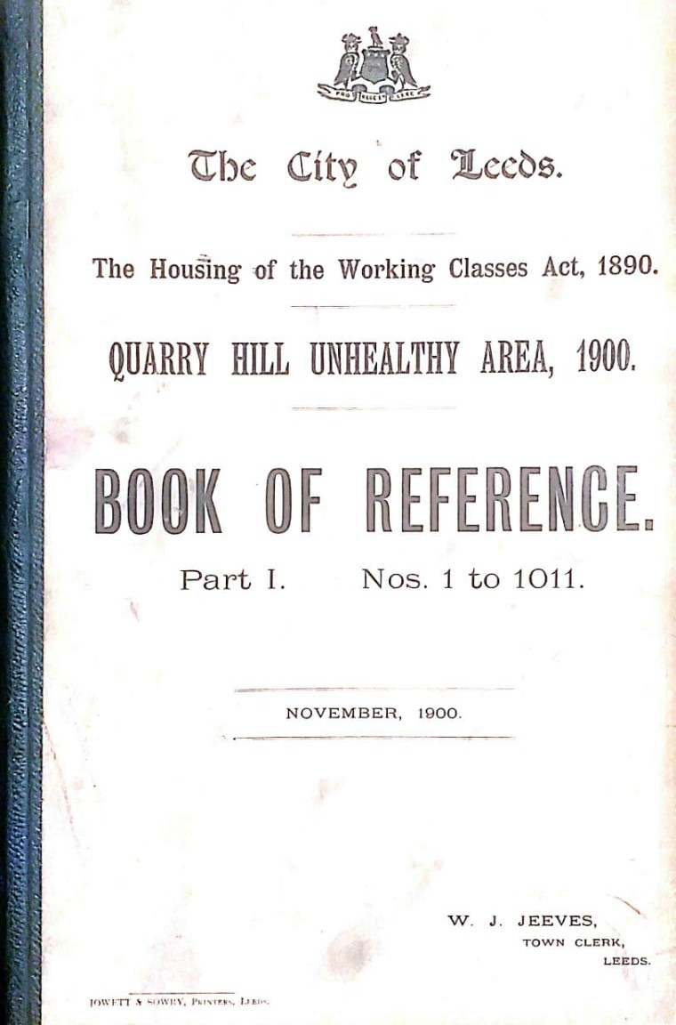
Area of Study
This investigation focuses on the first volume of the Quarry Hill Unhealthy Area, 1900 reference book, which contains 1,011 property entries representing the study’s overall population .
Serial No. | Volume | Published | Entries
1. | Part I | November 1900 | 1 - 1011
2. | Part II | “ | 1012 - 1858
3. | Part III | “ | 1858 - 2750
4. | Part IV | “ | 2751 - 3435
(Jeeves, November 1900)
Notes:
Quarry Hill unhealthy area, reference book has four parts. However, this investigation focuses on the first volume, which contains 1,011 entries representing the study’s overall population.

Slide 7
Research Questions
RQ 1: What was the occupational profile of Quarry Hill residents in the 1900s?
RQ 2: How do the available jobs impacted the average life expectancy of Quarry Hill residents in the 1900s?
RQ 3: How did the tenants contribute to Quarry Hill’s socioeconomic fabric during the early 1900s, despite being an unhealthy living area?
Notes:
The research questions that will be addressed in this presentation are as flash.

Slide 8
“This reference book offers a comprehensive overview of Quarry Hill, including information about its properties, streets, reserve plots, and property’s owners and tenants. As an industrial city, the majority of its residents were worker tenants. Our group has focused on researching the available professions during the 1900s and comparing them to those in today's digital era.”

Slide 9
Data Collection and Sample Size
To provide preliminary insights and explore likely trends and patterns in the data for future research directions, a random sample of 100 properties was selected to ensure a suitable representation of the population.
Notes:
A random sample of 100 properties was selected for this preliminary investigation to ensure a suitable representation.
As shown in the graph, out of 100 houses, 93 were occupied while 7 were vacant.
Moreover, out of 93 properties, 68 were male occupants; and 25 were female.

Slide 10
RQ 1: What was the occupational profile of Quarry Hill residents in the 1900s?
Notes:
The bar graph shows the occupational profile of the residents. Among 93 occupants, 69 were employed, whereas 24 were unemployed.
Furthermore, 67 employed individuals were male, while only 2 were female.
Additionally, The low employment of women indicates a lack of opportunities for females or maybe the difficulties they face at work due to gender-based discrimination.

Slide 11
RQ 1: What was the occupational profile of Quarry Hill residents in the 1900s?
Notes:
The research findings presented on the graph shows that the individuals' professions reflect the diverse skills and trades required to support the local economy. The dominant professions were related to tailoring, footwear, and education, with Tailors and Boot Makers being the most common, followed by teachers and brokers. Moreover, the presence of skilled persons, such as Painters, Cabinet Makers, plumbers, and cobblers, implies expertise valued by residents as well as in the factories.

Slide 12
RQ 1: What was the occupational profile of Quarry Hill residents in the 1900s?
Notes:
The graph displays a range of professions, such as mechanic, machinist, and engineer among the residents, demonstrating the area's industrialization and technological advancement. Additionally, bakers, grocers, fish, poultry, and milk dealers represent a flourishing local economy focused on food production.

Slide 13
RQ 1: What was the occupational profile of Quarry Hill residents in the 1900s?
Notably, the absence of doctors, and paramedical staff, among the occupants suggests a high level of awareness of the poor living conditions in the area. This trend underscores the challenges faced by the community and highlights the shortcomings of the healthcare system as well as Quarry Hill’s unhealthy conditions.
Notes:
Absence of Doctors

Slide 14
RQ 2: How do the available jobs impacted the average life expectancy of Quarry Hill residents in the 1900s?
Overall, these available professions reflected a dynamic and diverse community with varying needs, skills, and aspirations. Although some occupations were more lucrative than others, all of them contributed to the socioeconomic fabric of the area and influence the life cycle of the residents. Analyzing these professions provides insight into the historical context and social dynamics of Quarry Hill's condition. In future research, further analysis will be conducted to gain a deeper understanding of the impacts experienced by low-income families.

Slide 15
RQ 3: How did the tenants contribute to Quarry Hill’s socioeconomic fabric during the early 1900s, despite being an unhealthy living area?
However, in future research, we will investigate the specific contributions of skilled tenants to the local economy in detail.
Notes:
This research examines how industries and factories in Quarry Hill during the 1900s attracted working-class people to the area. As shown on the bar graph, out of 93 houses, 68 were occupied by tenants, while only 6 families owned their homes. Despite the unhealthy living conditions, the tenants moved to Quarry Hill and contributed to the area's economy by providing a skilled workforce for the industries and factories.

Slide 16
Rationale of the Study
The selection of 100 properties as a sample was based on the following rationale:
  The sample was chosen for a preliminary investigation to explore potential trends and patterns in the data for future studies.
  The sample was selected considering time sensitivity, as obtaining in-depth insight into the population it is more convenient.
  The sample size is reasonable for initial study due to resource and time constraints.

Slide 17
What can we learn from the experiences of Quarry Hill’s unhealthy conditions during the early 1900s, and how can this reference book help us to understand the current condition in the modern era?
The analysis of the data from the reference book highlights the consequences of poor living conditions and health vulnerabilities among individuals residing in low-income areas. This issue persists in modern times, particularly in low-income areas where residents may overlook the importance of cleanliness in their surroundings and have limited access to education and healthcare.

Slide 18
What can we learn from the experiences of Quarry Hill’s unhealthy conditions during the early 1900s, and how can this reference book help us to understand the current condition in the modern era?
Moreover, the reference book illuminates the effects of large industrialization in Quarry Hill, surrounded by housing communities in the 19th century. We continue to observe a similar impact on health outcomes in the modern era. Where due to massive urbanization, cities often experience higher rates of chronic diseases and mental health issues.

Slide 19
What can we learn from the experiences of Quarry Hill’s unhealthy conditions during the early 1900s, and how can this reference book help us to understand the current condition in the modern era?
Furthermore, the reference book indicates that the occupants of Quarry Hill in the early 1900s were mostly skilled tradespeople, such as tailors, showing that fashion trends were not widespread at that time. However, in modern times, ready-made clothing brands have gained extensive popularity and accessibility, leading people to prefer branded clothing over locally-stitched garments.

Slide 20
What can we learn from the experiences of Quarry Hill’s unhealthy conditions during the early 1900s, and how can this reference book help us to understand the current condition in the modern era?
Additionally, the absence of paramedical workers among residents of Quarry Hill highlights that health professionals preferred to reside in clean and high-quality housing societies. This trend continues to be observed globally in modern times, possibly because these individuals are aware of the impact of unhealthy environments on health and are often compensated by the government, allowing them to afford high-ranking housing societies.

Slide 21
What can we learn from the experiences of Quarry Hill’s unhealthy conditions during the early 1900s, and how can this reference book help us to understand the current condition in the modern era?
Subsequently, the residents of Quarry Hill during the early 1900s could not mobilize and advocate for better living conditions, possibly because many were outsiders who needed to prioritize these issues. In contrast, modern times recognize community engagement and empowerment as significant factors in decision-making that can bring positive societal changes.

Slide 22
What can we learn from the experiences of Quarry Hill’s unhealthy conditions during the early 1900s, and how can this reference book help us to understand the current condition in the modern era?
Overall, The historical reference book “Quarry Hill Unhealthy Area, 1900s” highlights the importance of addressing social issues such as pay disparity, access to healthcare, education, and community engagement in low-income communities. By prioritizing these factors, state and state institutions have successfully promoted or attempted to encourage healthy environments and reduce health and income disparities in the modern era.

Slide 23
Future Research Directions
The reference book provides a glimpse into the socioeconomic and demographic profile of Quarry Hill in the early 1900s. The preliminary research explored the potential trends and patterns in the data. Therefore, the analysis helps us to develop more targeted research questions and sampling strategies for future research studies, for example.
  Why did no government service servants live?
  how did the residents of Quarry Hill pay their rent?
  What were the reasons behind the residents' lack of concern for cleanliness?
  What medical facilities were available to the residents?
  What was the impact of having only four teachers among the occupiers on education?
  Why did medical professionals like doctors and paramedics avoid renting houses?
  How different jobs impacted the average life expectancy of residents?

Slide 24
References
Jeeves, W.J. November 1900a. Quarry Hill Unhealthy Area, 1900. Leeds: Jowett & Sowry, Printers.
Jones, C. 2021. Yorkshire Historic. Available from: https://www.facebook.com/groups/598300550814880/posts/853341741977425/
Leodis by Leeds Libraries. [Online]. Available from: https://www.leodis.net/
Memories of Quarry Hill. 2013. McGuire, M. dir.
Ravetz, A. 2013. Model Estate (Routledge Revivals): Planned Housing at Quarry Hill, Leeds. Routledge.

Slide 25
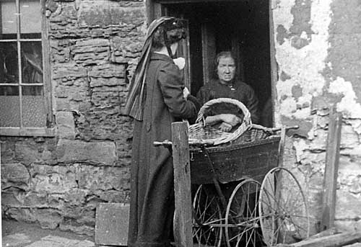
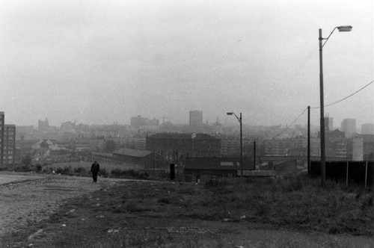
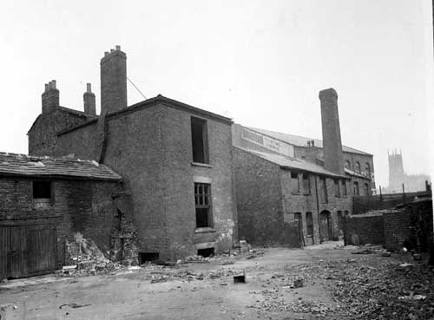
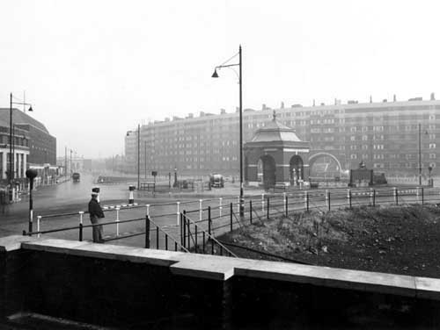
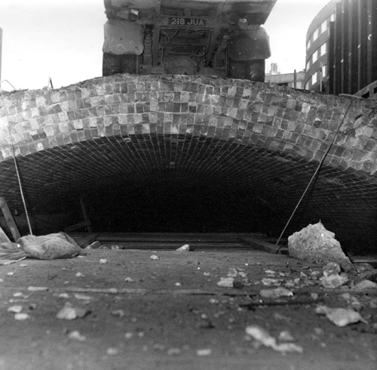
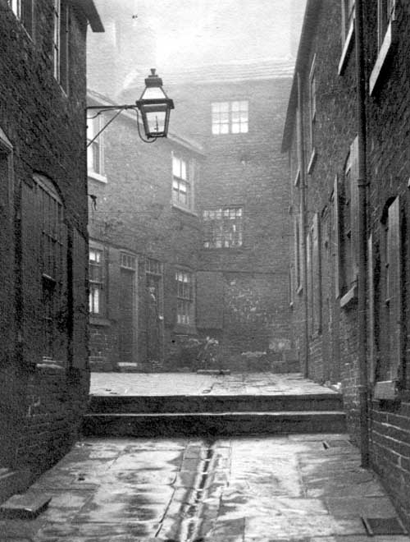
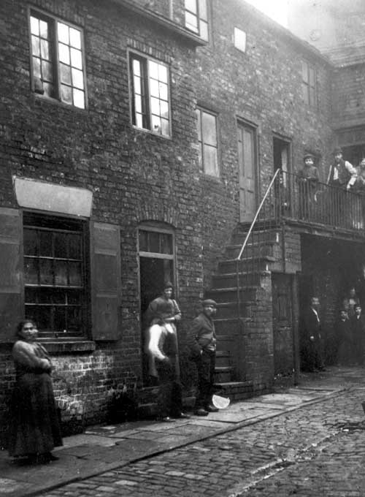
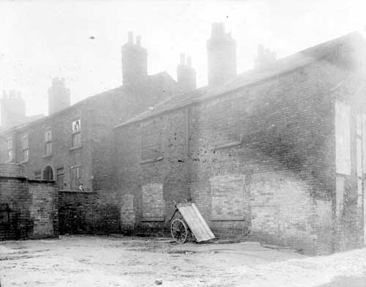
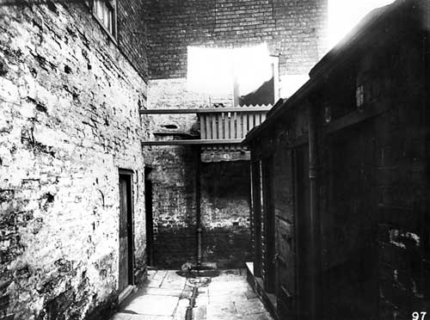
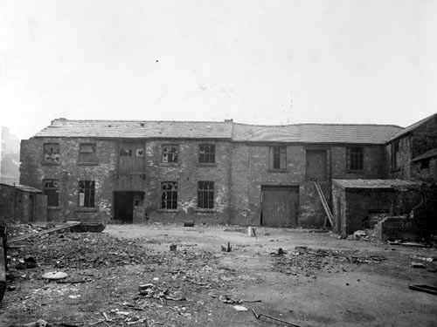
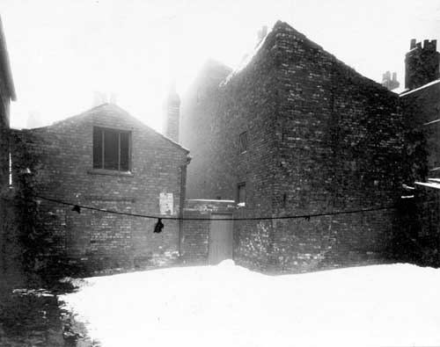
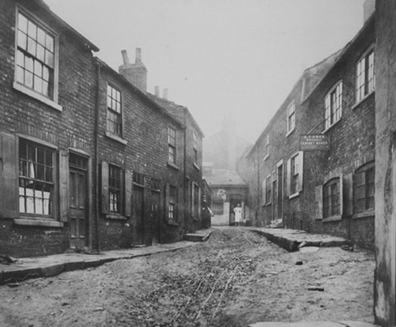
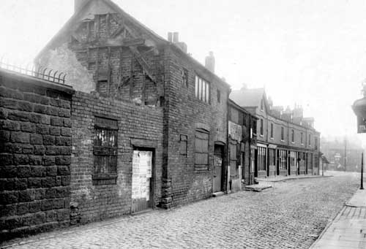
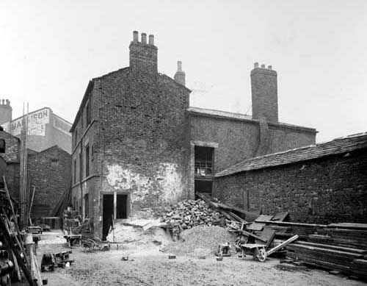
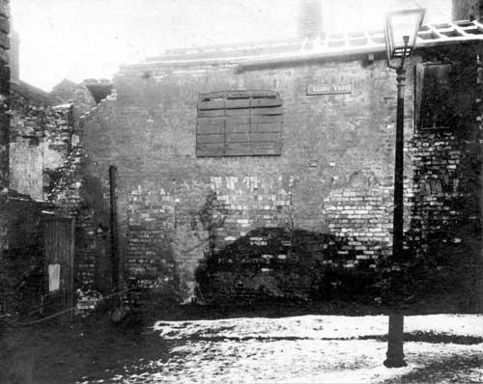
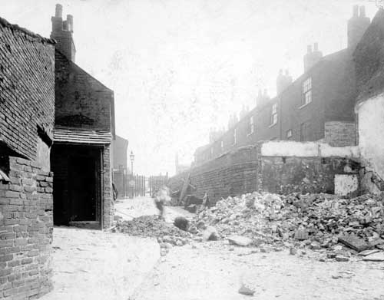
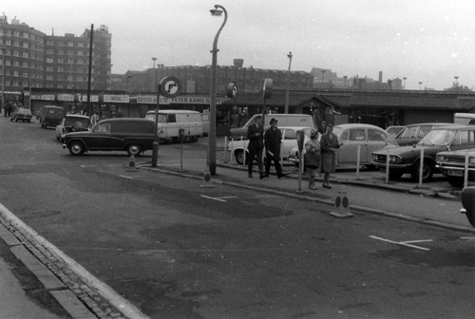
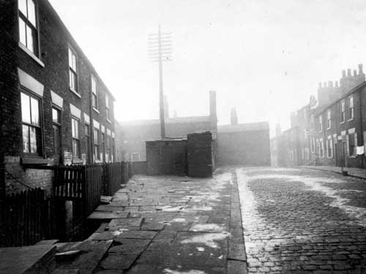
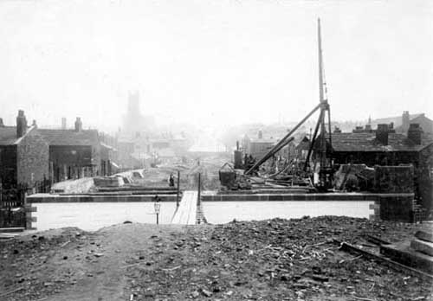
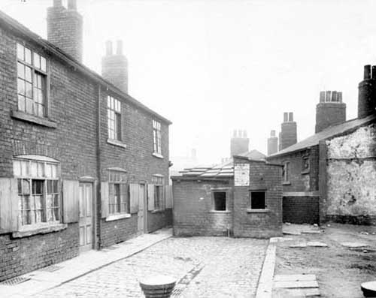
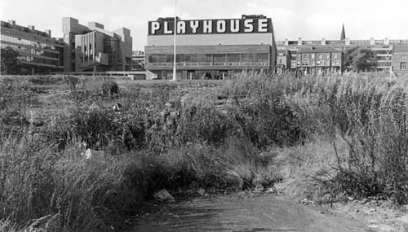
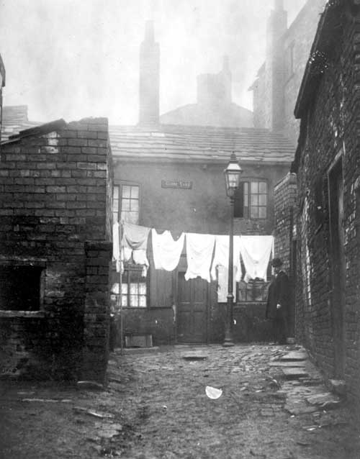
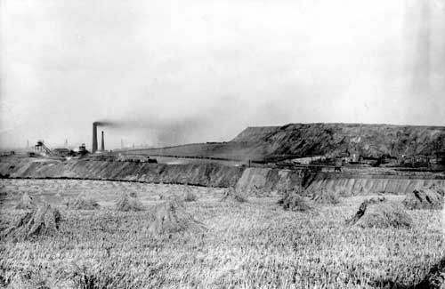
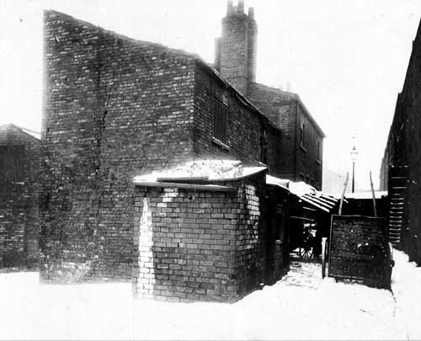
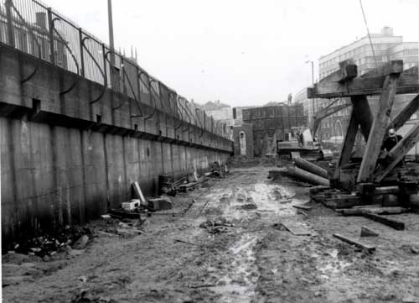
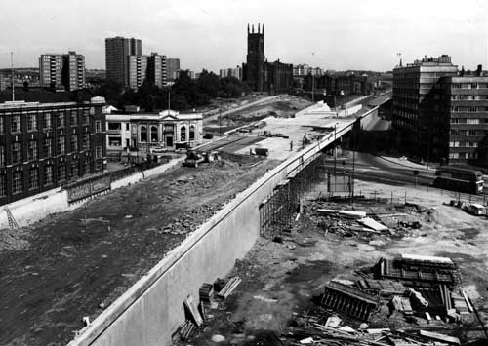
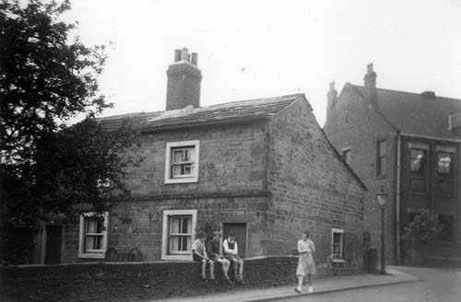
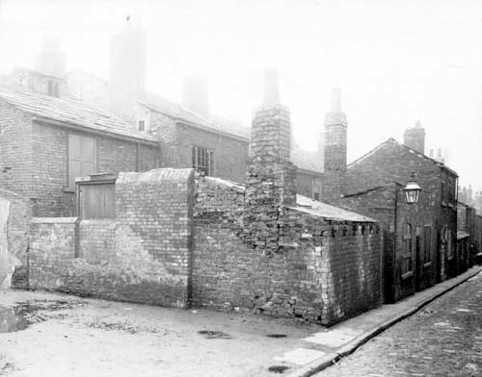
QUARRY HILL UNHEALTHY AREA, 1900. BOOK OF REFERENCE. VOLUME I
Thank You…….
COMM5780M DIGITAL PRACTICES

